Slide 1
Event Driven Linux Device Driver which Records Position of Mouse And communicate Over Various Interfaces

Slide 2
OBJECTIVE :
The objective of this project is to develop an event-driven Linux device driver that records real-time mouse position using the Linux Input Subsystem. Based on quadrant logic, the driver communicates with multiple hardware interfaces such as SPI (Display), UART, and GPIO using MMIO .
Tools & Technologies:
C(Kernel space), Linux Kernel Drivers(GPIO, SPI, UART), Input Subsystem, Work-queues, SPI ILI9225 TFT Display, DTS, Make, Raspberry Pi.

Slide 3
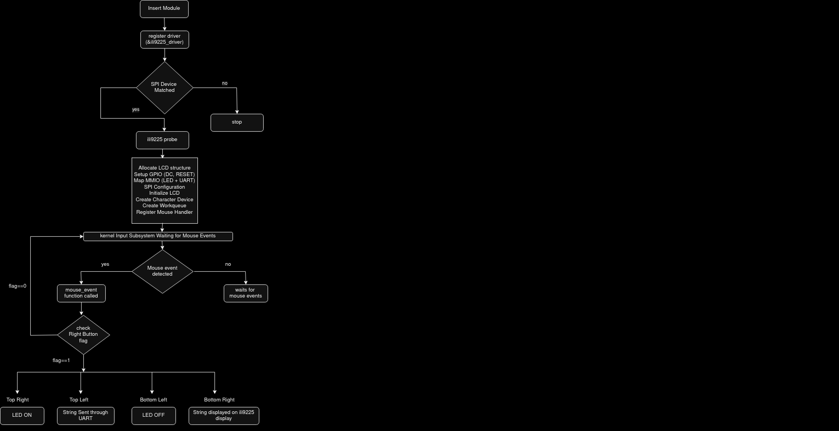
FLOW CHART :

Slide 4
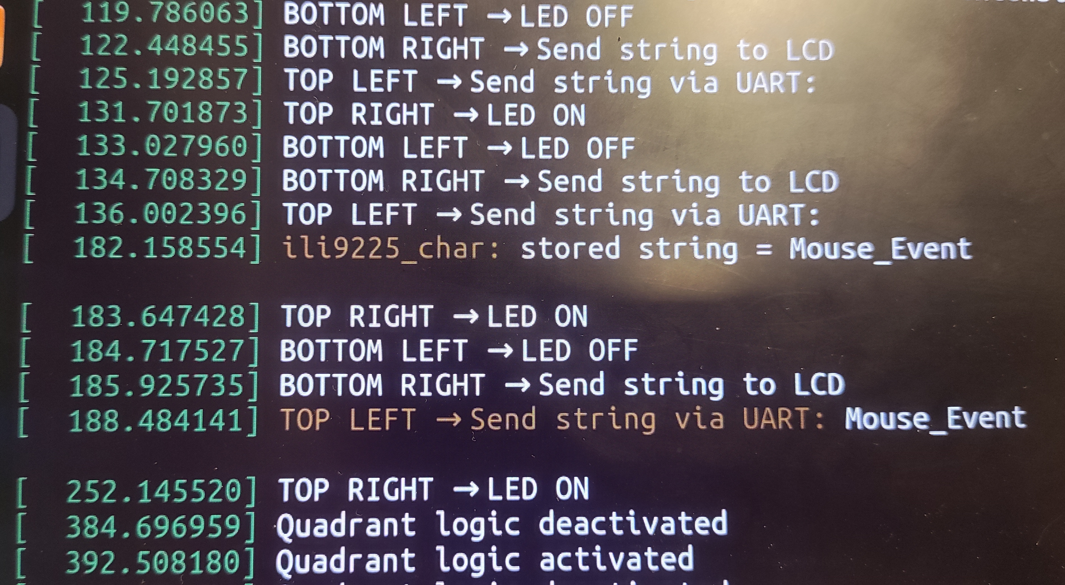
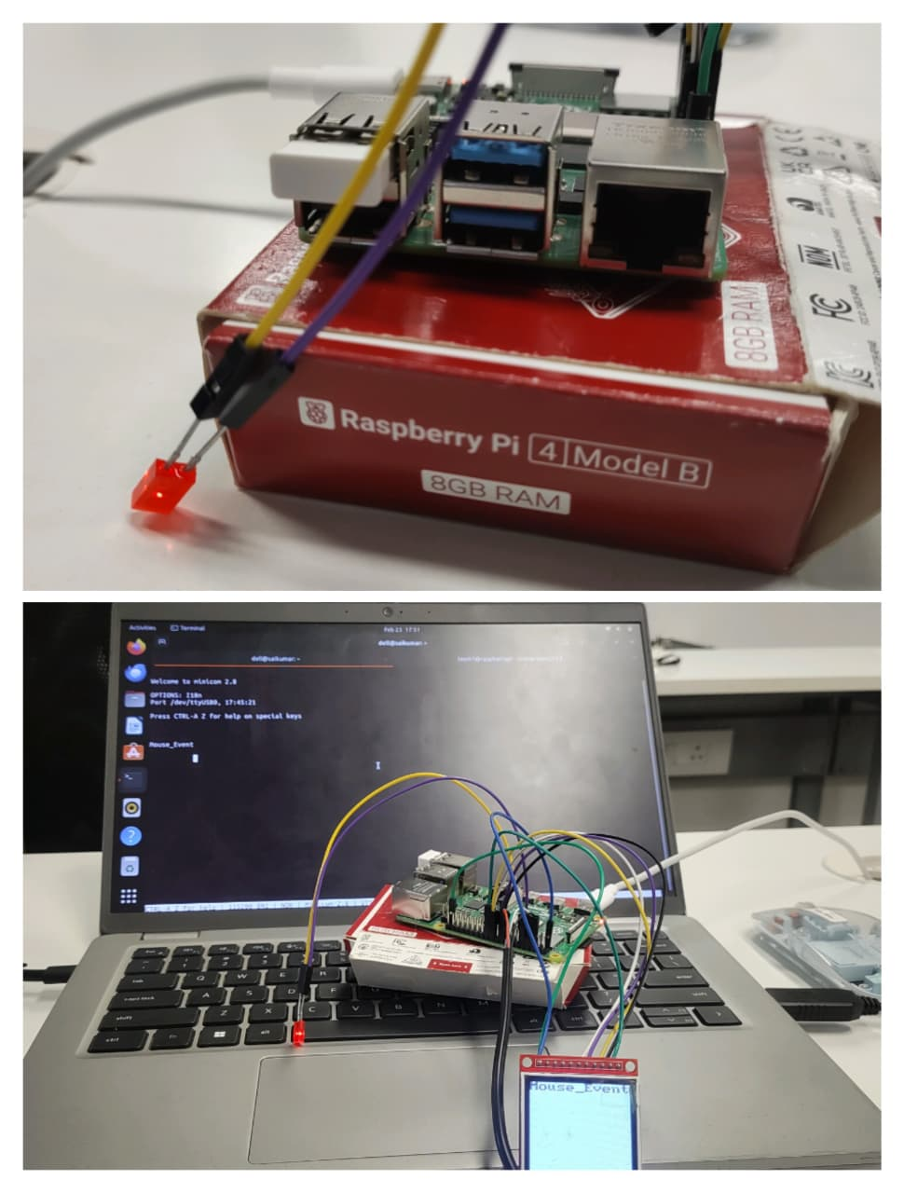
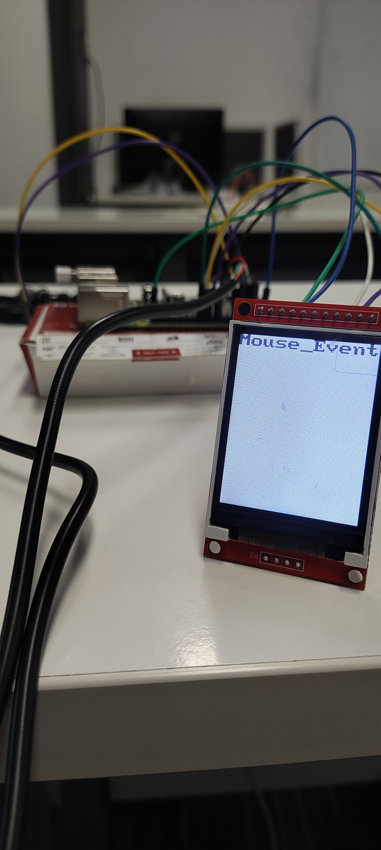
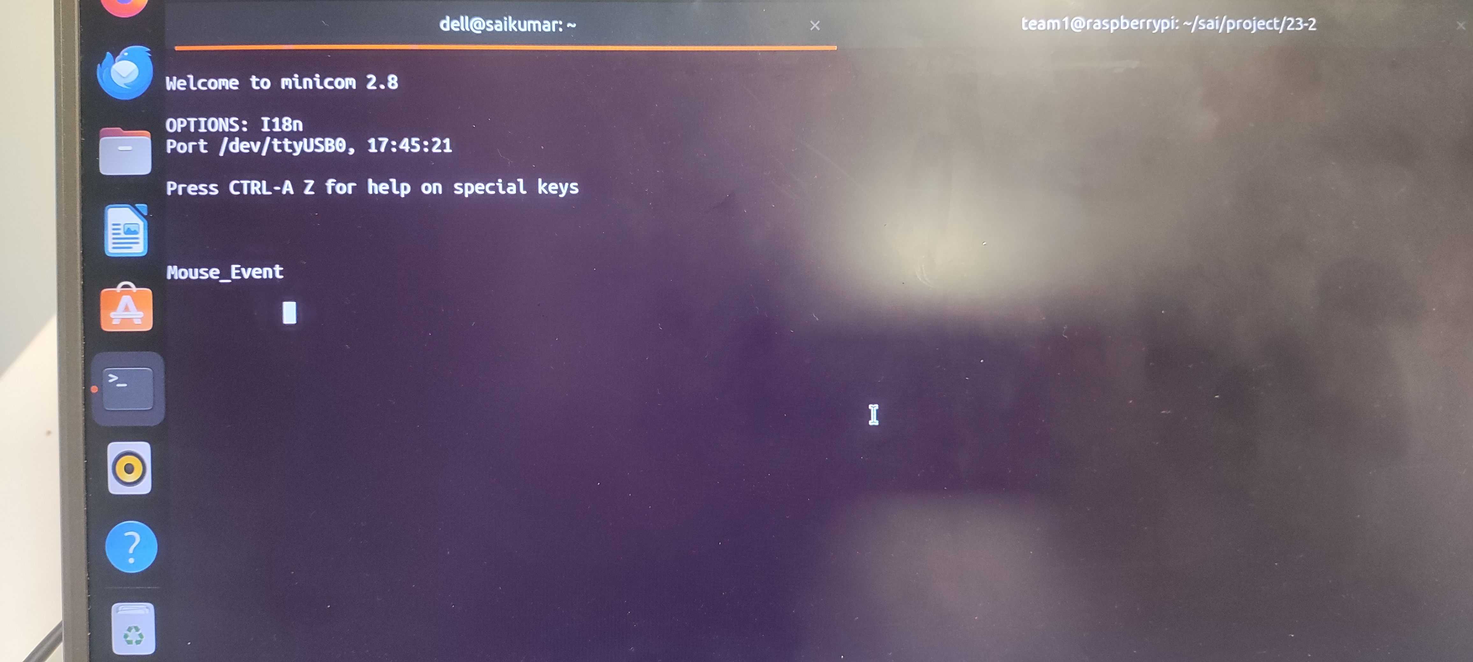
RESULTS:

Slide 5
CONCLUSION:
This project implements an event-driven Linux kernel driver controlled by mouse actions.
Based on mouse position and clicks, the system communicates through UART, controls an LED using GPIO, and displays data on the IlI9225 Display using SPI.
It integrates multiple kernel subsystems into one unified and interactive design.
Overall, the project demonstrates strong understanding of kernel-level programming and real-time hardware control.
Team Members
B. Sai Kumar
S. Praneeth

